Slide 1
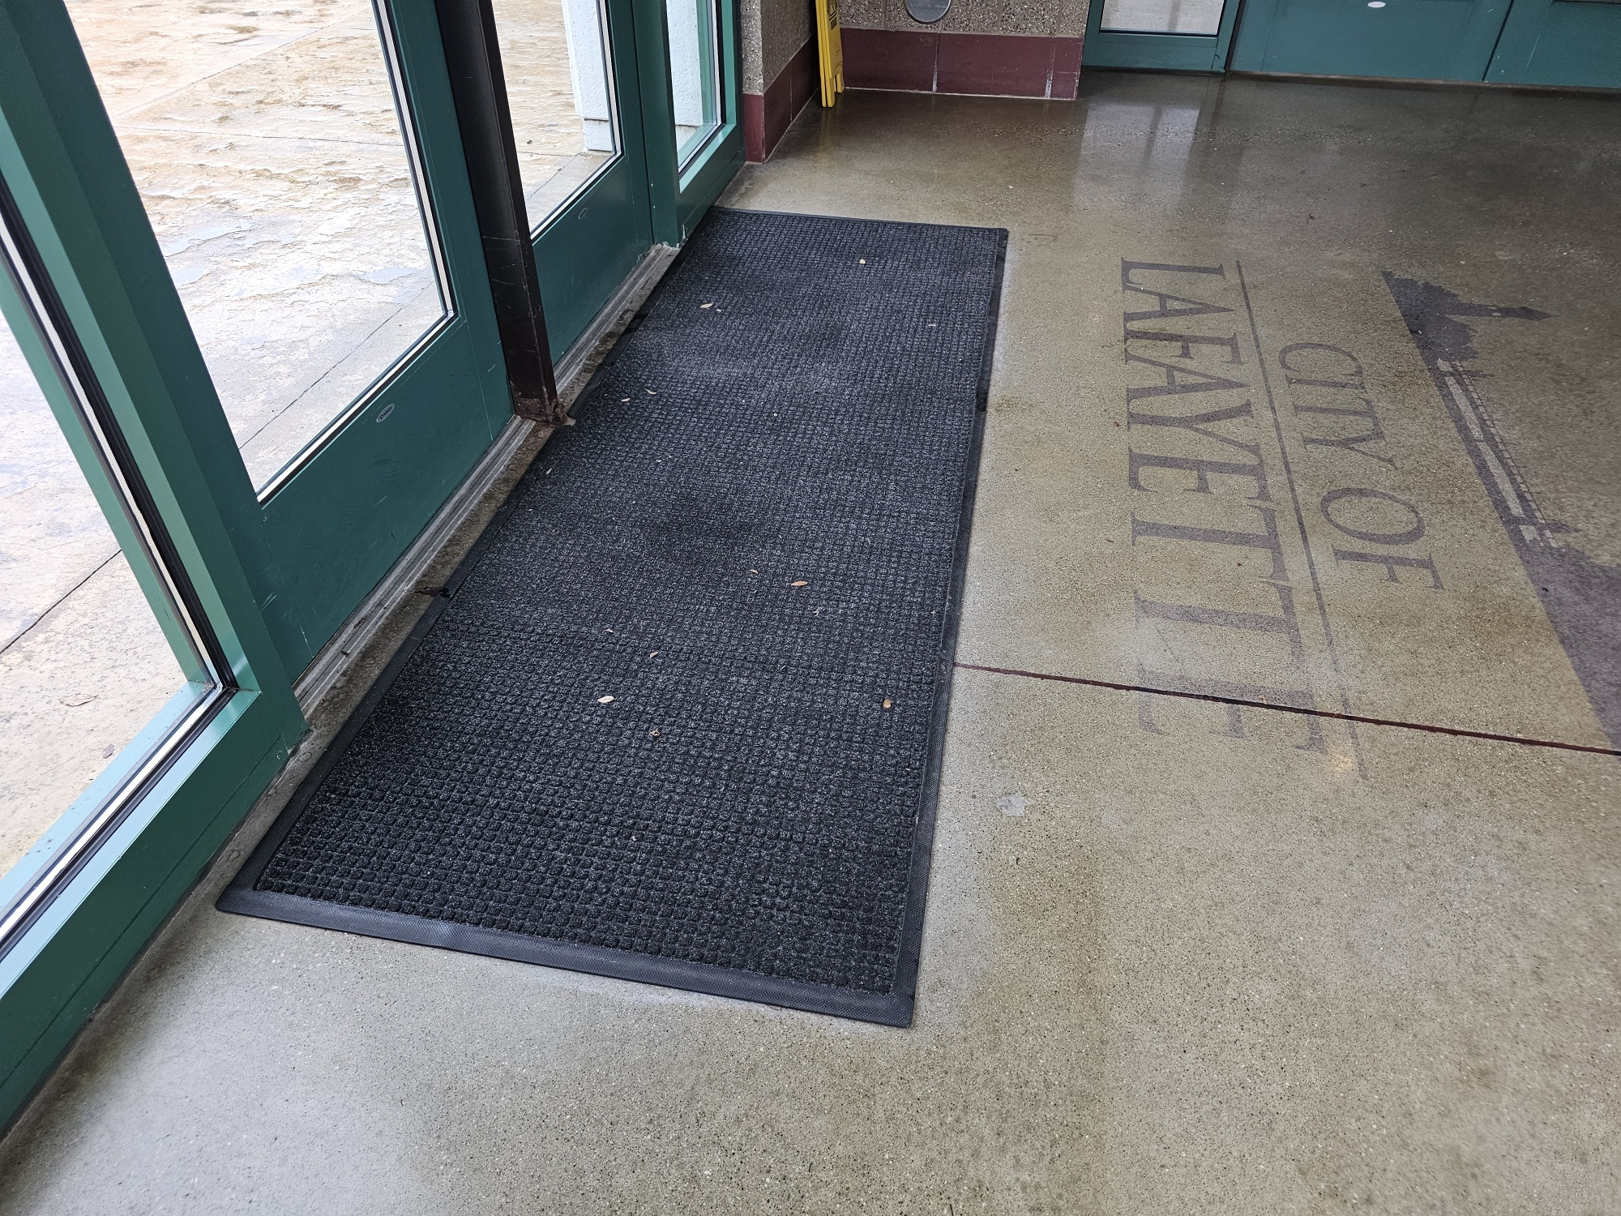
Ada checklist
PRIORITY 1
APPROACH AND
ENTRANCE
PARKING | CRITICAL FINDING | PHOTO | PHOTO AND DATE OF CORRECTION
PARKING 1.11 | NO VAN ACCESSIBLE SIGNAGE AT VAN ACCESSIBLE SPACES
EXTERIOR ACCESSIBLE ROUTE | CRITICAL FINDING | PHOTO | PHOTO AND DATE OF CORRECTION
ROUTE 1.13 | SEVERAL SECTIONS OF CURB NEED REPAIRED
ENTRANCE | CRITICAL FINDING | PHOTO | PHOTO AND DATE OF CORRECTION
ENTRANCE 1.49 | ENTRY MAT EDGES ARE NOT SECURELY ATTACHED
CRITICAL FINDINGS THAT NEED CORRECTION BASED ON THE 2010 ADA STANDARDS FOR ACCESSIBLE DESIGN

